Slide 1
MID-CAREER
&
NOT SATISFIED?

Slide 2
What do you do when? Your career feels off track?
Identifying the signs, behaviors and metrics that it’s time for a career tune-up

Slide 3
Determine Your Career Path
Current skills
Mentee
Lateral skills obtained
Mentor
Lateral skills needed
Notes:
Accept today that we may have many careers and goals in our lifetime. Some at the same time and some will have systematic growth. Where ever you are in your personal growth or professional journey, it is important to understand what path you are on and how to leverage it for your success.

Slide 4
[Personal]
[Professional]
[Organizations]
Who
is in YOUR network?
Task 1
List top 3 in each group who can help YOU.
List top 3 in each group who YOU can help.
Notes:
Understand that your network is both lateral and horizontal. Who you help today may be who helps you tomorrow and vice versa.

Slide 5
Your Value Proposition?
1
Key Performance Metrics – On the Job or self-evaluation
2
How do you present Your Value to others?
3
What can others say about you?

Slide 6
1
KPIs for You

Slide 7
What you do best & how is it measured?
?
Measuring yourself: Either against the goals of your job or position or against the models of successful people who have what you want will help align your reality with your goals.
Even the simple things: What time do you arrive at the office, what time do you leave? Are you prepared for customer or work meetings? Do you articulate and follow-up on your commitments and assignments? Do you complete them accurately and with our without the collaboration and input of others?
Notes:
Your performance review or worst case when you’ve been downsized is not the time to determine what makes you valued or understand why you were perceived as not valuable to the organization

Slide 8
2
How do you Present Your Value to Others?
Notes:
Ever hear the words he/she has an attitude problem. Not a team player or worse yet your TONE makes people uncomfortable. These are key words and triggers that could be sabotaging your career. Are you able to accept feedback and see yourself as others see you?

Slide 9
Your Name
BACKGROUND:
Basic details about your role
Key information about your company
Relevant background info, like education or training & skills acquired
DEMOGRAPHICS:
Gender
Age Range
Urbanicity (Is your persona urban, suburban, or rural?) How does this relate to the environment you want success in?
IDENTIFIERS:
What are the words you use to describe yourself?
What do people remember/say about you? (Mannerisms)
How you see yourself and how others see you.

Slide 10
Your Name
GOALS:
YOUR primary goal
YOUR secondary goal
CHALLENGES:
Primary challenge to YOUR success
Secondary challenge to YOUR success
IDENTIFY WHO CAN HELP:
You solve your YOUR challenges
You achieve your goals
Ask for feedback and be willing to challenge yourself

Slide 11
3
What can others say about you?

Slide 12
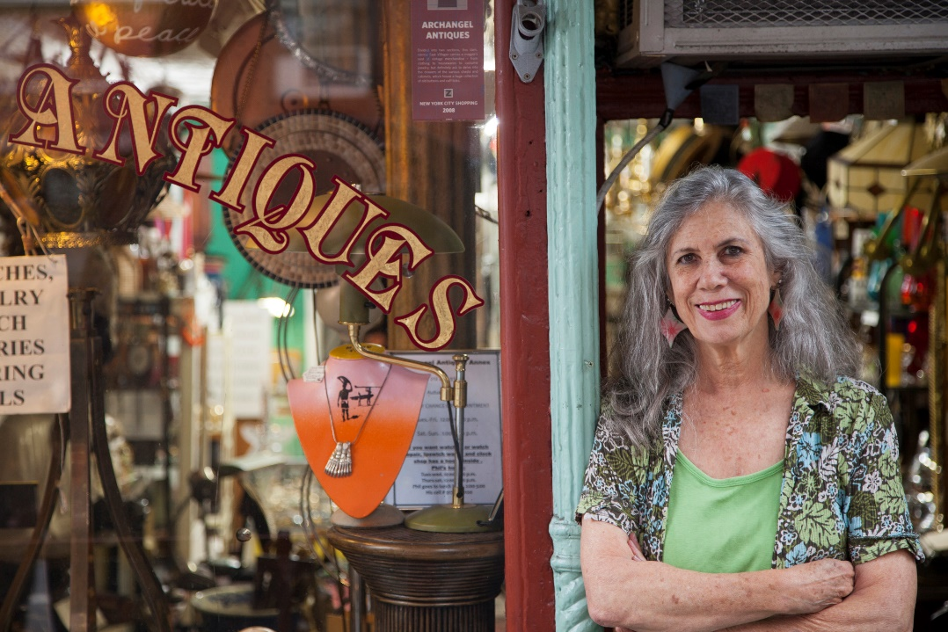
Sample Susan
BACKGROUND:
Small Business Shop Owner
Worked at the same company for 20 years; worked her way up from HR and started company after downsizing
Married with 2 grown children
DEMOGRAPHICS:
Skews female
Age 55-75
Dual HH Income: $180,000
Suburban
IDENTIFIERS:
Calm demeanor
Likes personal contact; developing relationships matter
Focused on pleasing others
Asks for suggestions & feedback

Slide 13
Sample Susan
GOALS:
Keep employees happy and expand employment opportunities
Grow by expanded products and customer segments.
CHALLENGES:
Getting everything done with a small staff
Doesn’t know how to market her small business effectively
IDENTIFY WHO CAN HELP:
Peer owner or leadership support group
Network of professionals or advisors who can help Susan verbalize and promote her strengths.

Slide 14
Sample Susan
REAL QUOTES:
“After grandma died, Susan searched for weeks helping me find a vintage lampshade to match the one broken during the move. She made it her personal goal to restore our cherished heirloom.”
“Susan helped us see the treasures we already had and connected us with a restoration service to refinish our dining room table instead of selling us something we didn’t need.”
COMMON OBJECTIONS:
I’m worried I can’t keep bigger pieces in stock for designers and decorators because of cash flow.
I’m worried I can’t afford to delegate buying estate items to my employees. They won’t have my ‘eye’ .

Slide 15
Ready for Success?
Register for our 1 Hour Consultation - $50
New clients receive $100 credit toward services requested.
Want this presentation? email info@fcg-grp.com
http://fcggroupcreative.com
918.280.0006
5566 S. 79th E. Place, Suite C
MANAGEMENT CONSULTING | BUSINESS PLAN DEVELOPMENT | MARKETING & ANALYTICS | RFP & PROPOSAL DEVELOPMENT

